Slide 1
Decision Support Systems Concepts

Slide 2

DSS Defined
Are computer based information systems that provide interactive information support to managers and business professionals during decision marking process.
DSS uses analytical models, specialized databases, a decision marker owns insights and judgments and computer based modeling process to support decision making.
DSS is used to support both semi-structured and unstructured decisions.

Slide 3
Common DSS Characteristics
Employed in semi-structured or unstructured decision contexts
Intended to support decision makers rather than replace them
Supports all phases of the decision-making process
Focuses on effectiveness of the process rather than efficiency
Is under control of the DSS user

Slide 4
Common DSS Characteristics (cont.)
Uses underlying data and models
Facilitates learning on the part of the decision maker
Is interactive and user-friendly
Is generally developed using an evolutionary, iterative process
Can support multiple independent or interdependent decisions
Supports individual, group or team-based decision-making

Slide 5
What A DSS Can and Cannot Do
The DSS is expected to extend the decision maker’s capacity to process information.
The DSS solves the time-consuming portions of a problem, saving time for the user.
Using the DSS can provide the user with alternatives that might go unnoticed.
It is constrained, however, by the knowledge supplied to it.
A DSS also has limited reasoning processes.
Finally, a “universal DSS” does not exist.

Slide 6
History of Decision Support Systems
The concept was born in the early 1970s, attributed to articles by J.D. Little and Gorry and Scott Morton.
Little observed that managers did not use management science models because they were not simple, robust or adaptive.
The Mortons coined the term DSS and developed a two-dimensional framework for computer support of managerial activity.

Slide 7
Ingredients of a DSS
Alter classified DSS components into seven categories depending on how they impacted the decision.
Another approach focused on the language provided by the DSS to work with data.
Building on these, the basic components of a DSS can be stated as:
  The data management system
  The model management system
  The knowledge engine
  The user interface
  The users

Slide 8
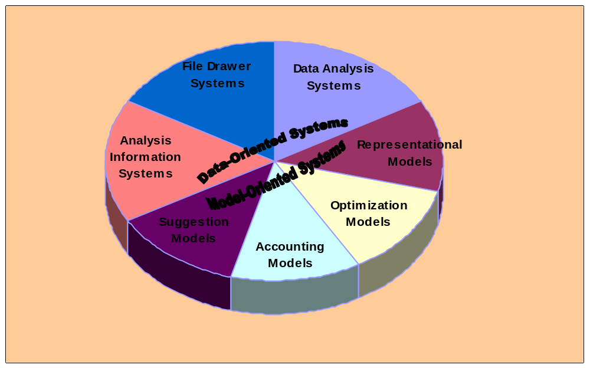
Alter’s Classification of DSS Components

Slide 9
Components of DSS
Data
Information System
Decision Support System
Graphical User Interface
Models Optimization Simulation Statistical
Presentation of Results
Knowledge Historical Expertise
Data Analysis

Slide 10
Data and Model Management
An increasing focus on the value of data to an organization pointed out that the quality and structure of the database largely determines the success of a DSS.
A database organizes data into a logical hierarchy based on granularity of the data.
The hierarchy contains four elements:
1. Database 2. Files
3. Records 4. Data elements

Slide 11
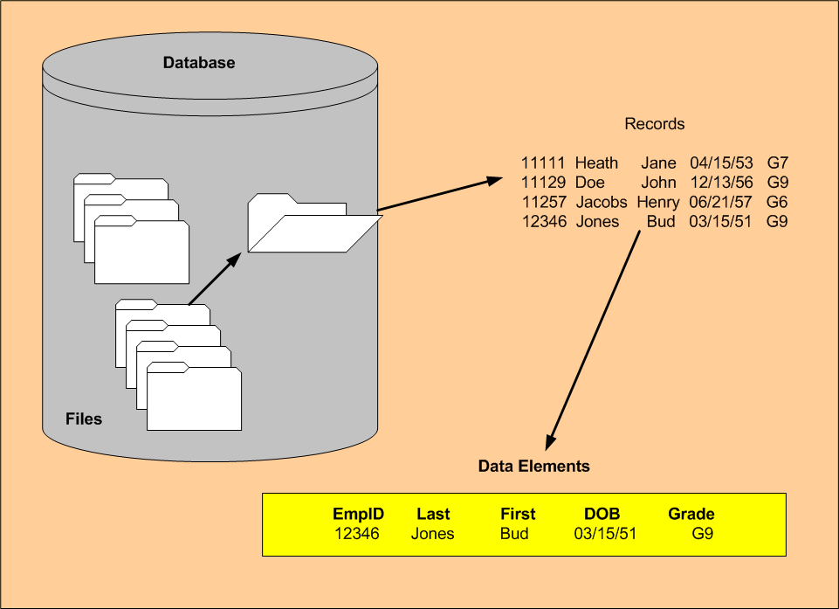
Hierarchy of Data

Slide 12
The Database Management System
Even though the data within each file have a common structure (the record), the files themselves may be quite diverse.
The important role of organizing the files and databases goes to the DBMS.
The two main responsibilities of the DBMS are:
  Coordinating the tasks related to storing and accessing information.
  Maintenance of the logical independence between the data in the DSS database and the DSS application.

Slide 13
General Functions of the DBMS
Data definition – providing a data definition language and allowing for interrelation of data
Data manipulation – providing a query language, allowing for capture and extraction
Data integrity – allows user to describe rules that maintain integrity and check for errors

Slide 14
General Functions of the DBMS (cont.)
Access control – allows identification of users, controls access and tracks usage
Concurrency control – provides procedures for controlling the effects of simultaneous access
Transaction recovery – provides mechanisms for restart and reconciliation in the event of hardware failure

Slide 15
The Model Base
A model is a simplification of some event constructed to help study the event.
The model base is the modeling counterpart to the database; it stores and organizes the various models the DSS uses in its analyses.
The MBMS (or model base management system) is the counterpart to the DBMS.
The model base is what differentiates a DSS from other information systems.

Slide 16
General Functions of the MBMS
Modeling language – allows for creation of decision models, provides a mechanism for linking multiple models
Model library – stores and manages all models, provides a catalog and description.
Model manipulation – allows for management and manipulation of the model base with functions (run, store, query, etc.) similar to those in a DBMS.

Slide 17
DSS Knowledge Base
Any true decision requires reasoning, which requires information.
The knowledge base is where all of this information is stored by the DSS.
Knowledge can just be raw information, or rules, heuristics, constraints or previous outcomes.
This knowledge is different from information in either the database or model base in that it is problem-specific.

Slide 18
Contents of the Knowledge Base
Knowledge in the base can be categorized into two simple groups.
Facts represent what we know to be true at a given time.
Hypotheses represent the rules or relationships we believe to exist between the facts.
The next slide shows how credit rules operate on facts about an individual that has applied for a loan.

Slide 19
Knowledge Acquisition and Retrieval
One or more people called knowledge engineers gather the information for the knowledge base. These people are specially trained in techniques for extracting this from experts in the domain.
The inference engine is the part of knowledge base that applies the rules to pull the information out in the form the user desires.

Slide 20
User Interfaces
An interface is a component designed to allow the user to access internal components of a system.
In general, the more common the interface, the less training need be provided to users. Think, how many Windows programs use the same menu structure as Microsoft Word?
The general functions of a DSS interface are the communication language and the presentation language.

Slide 21
General functions of the DSS Interface
Communication language – allows for interaction with the DSS in a variety of ways, identifies form of input (see the next slide), provides support to DSS users, captures previous dialogues so future interactions can be improved.
Presentation language – provides for presentation of data in a variety of formats, allows for detailed report generation, can provide multiple views of the data.

Slide 22
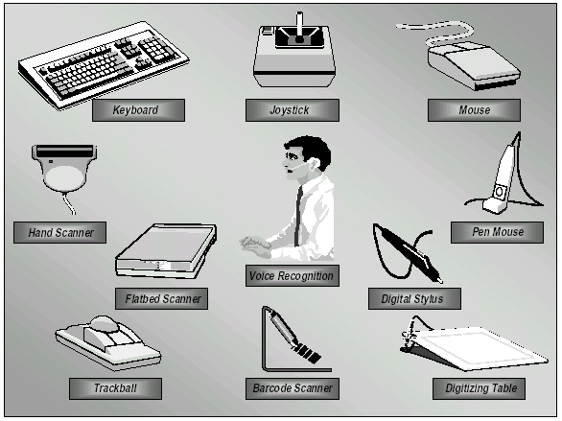
Common Input Devices

Slide 23
The DSS User
In a DSS, the user is as much a part of the system as the hardware and software.
User roles: Alter classified users into five categories (decision maker, intermediary, maintainer, operator and feeder).
Patterns of DSS use: Alter further classifies the various user roles into one of four basic patterns of use. The next slide illustrates those patterns.

Slide 24
DSS Application Areas
DSS can be used in :
  Hospitals for medical diagnosis
  Banks ( for loan allocation)
  Stock markets
  Manufacturing
  Organization support

Slide 25
Home Work
Identify and describe types of DSS’s

